Slide 2
Process Flow

Slide 3
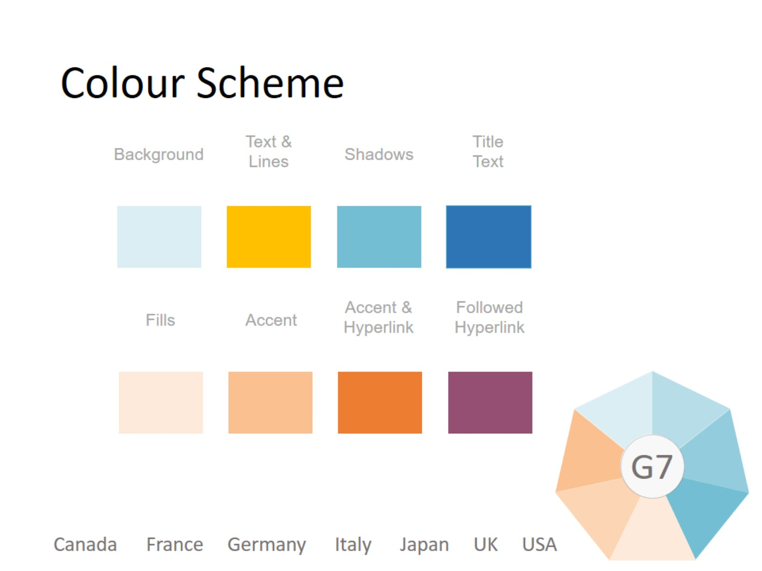
Colour Scheme

Slide 4
Picture Slide

